Slide 1
File Systems
Chapter 6
6.1 Files
6.2 Directories
6.3 File system implementation
6.4 Example file systems

Slide 2
File Systems
All computer applications need to store and retrieve information.
While a process is running, it can store a limited amount of information within its own address space.
However, storage capacity is restricted to size of virtual address space.
  For some applications this size is adequate
  For others such as banking or corporate record keeping, it is far too small.
A second problem with keeping information with a process’ address space is that when the process terminates, the information is lost.
  Having it vanish when the process using it terminates is unacceptable.
  Also, it must not go away when a computer crash kills the process.
A third problem is that it is frequently necessary for multiple processes to access the information or parts of it at the same time.

Slide 3
Long-term Information Storage
Must store large amounts of data
Information stored must survive the termination of the process using it
Multiple processes must be able to access the information concurrently
The usual solution to all these problems is to store information on disks and other external media in units called files.
Information stored in files must be persistent.
ie not be affected by process creation and termination
That part of the OS dealing with files is known as file system

Slide 4
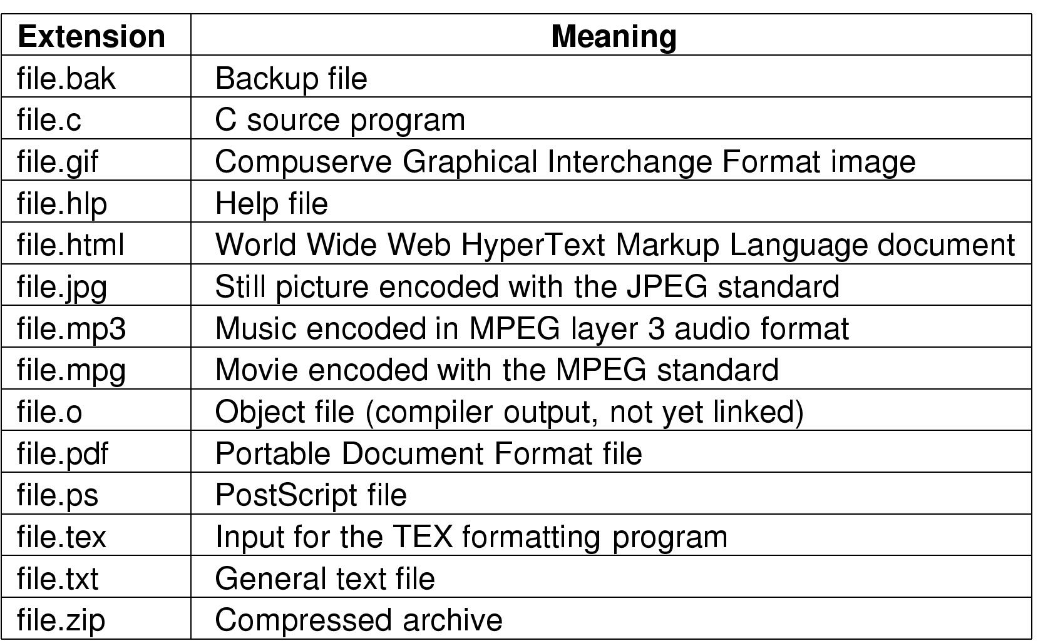
File Naming
Typical file extensions.

Slide 5
File Naming
Files are an abstraction mechanism.
They provide a way to store information on the disk and read it back later.
The most important characteristic of any abstraction mechanism is the way the objects being managed are named.
When a process creates a file, it gives the file a name.
  When process terminates, the file continues to exist and can be accessed by other processes using its name.
Exact rules for file naming vary somewhat from system to system, but all current OSES allow strings of one to eight letters as legal file names.
  Some distinguish between upper and lower case letters whereas others do not.
  UNIX falls in former, MSDOS in the latter.

Slide 6
File Naming
Many Oses support two-part file names, with the two parts separated by a period.
The part following the period is called the file extension and usually indicates something about the file.
  In MSDOS, file names are 1 to 8 characters plus an optional extension of 1 to 3 characters.
  In UNIX, the size of the extension if any is up to the user and a file may even have two or more extensions as in proc.c.Z where .Z is commonly used to indicate the c-file has been compressed using the Ziv-Lempel compression algorithm.
In some systems (UNIX), file extensions are just conventions and are not enforced by the OS.
  A file named file.txt might be some kind of text but that name is more to remind the owner than to convey any actual information to the computer.

Slide 7
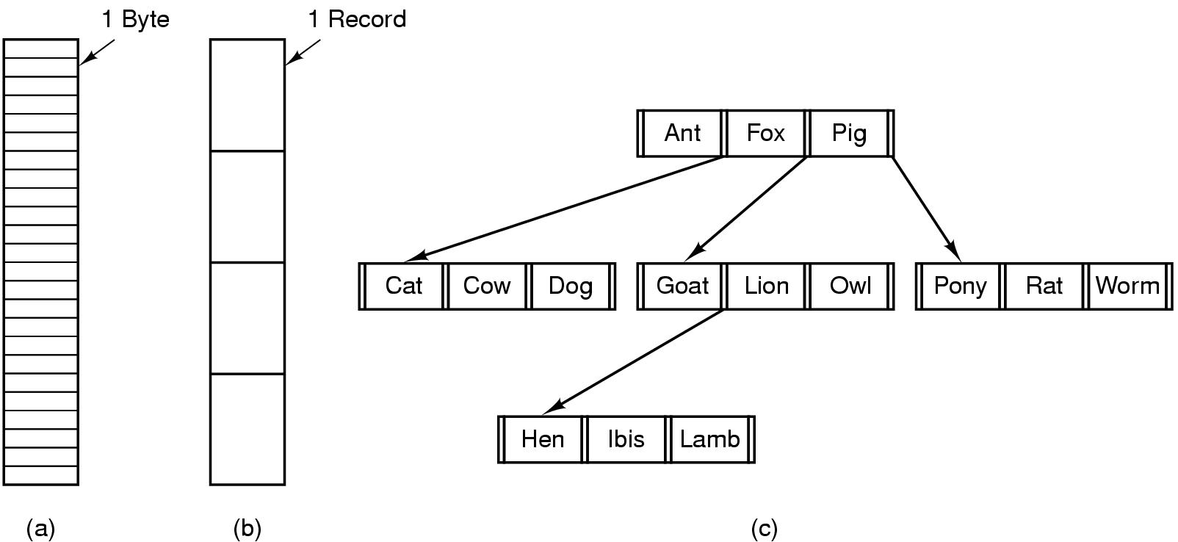
File Structure
Three kinds of files
  byte sequence
  record sequence
  tree

Slide 8
File Structure
Files can be structured in any of several ways:
  Byte sequence
  Record sequence
  Tree sequence
In the first way, the file is an unstructured sequence of bytes.
  Here, the OS does not know or care what is in the file.
  All it sees are bytes.
  Any meaning must be imposed by user-level programs.
The second way is the first step up in structure.
  Here a file is a sequence of fixed-length records, each with some internal structure.
  Central to this model, the read operation returns one record and the write operation overwrites or appends one record.
  No current general purpose system works this way.

Slide 9
File Structure
In the third kind of file structure, a file consists of a tree of records.
  Not necessarily all the same length, each containing a key field in a fixed position in the record.
  The tree is sorted on the key field, to allow rapid searching for a particular key.
  The basic operation is not to get the next record but to get the record with the specific key.
  Widely used on the large mainframe computers still used in some commercial data processing.

Slide 10
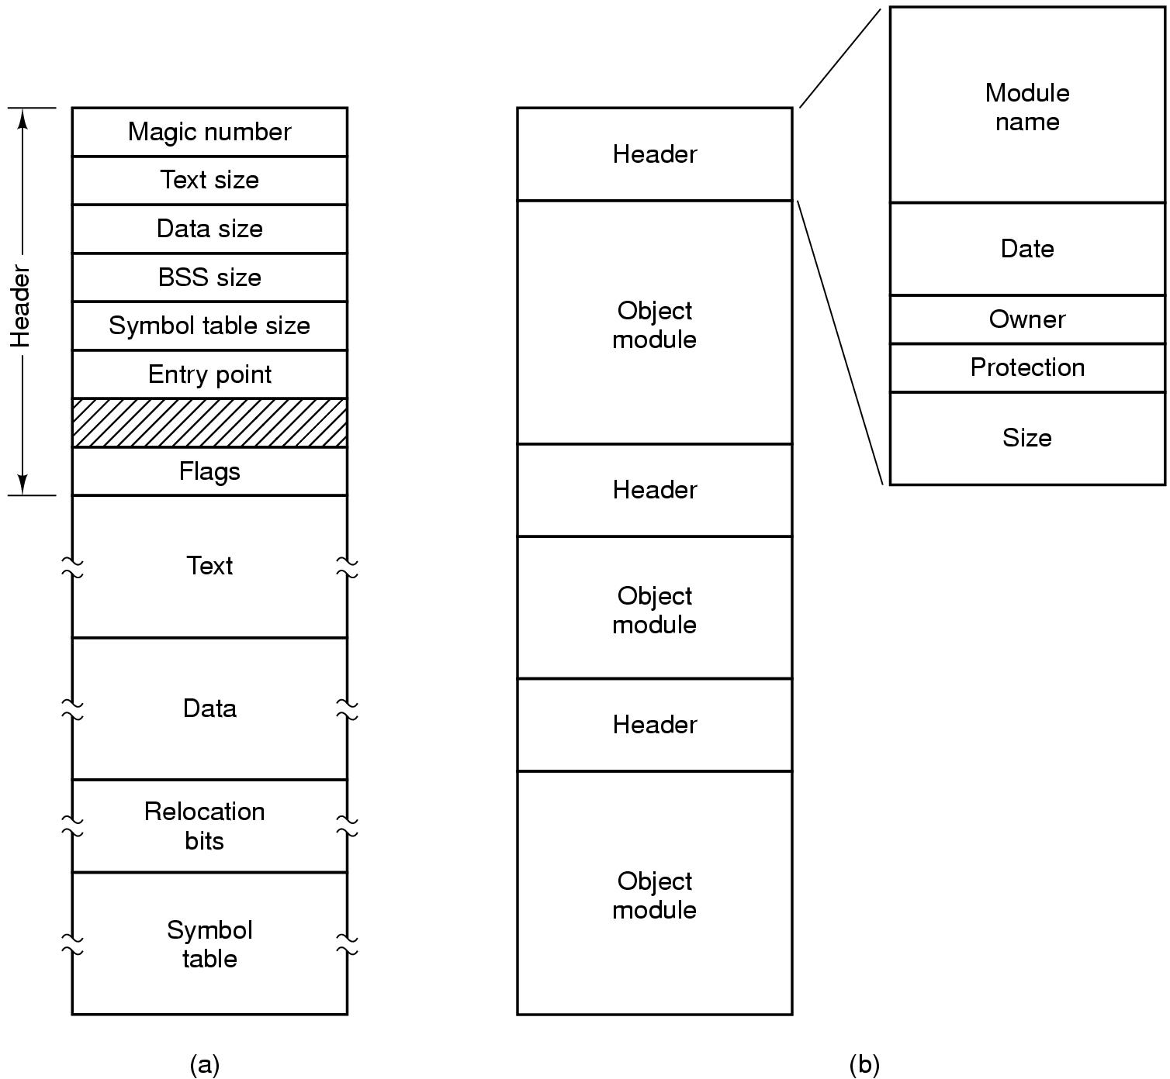
File Types
(a) An executable file (b) An archive

Slide 11
File Types
Many Oses support several types of files.
Regular files are ones that contain user information.
Directories are system files for maintaining the structure of the file system.
Character special files are related to I/O and used to model serial I/O devices such as terminals, printers etc
Block special files are used to model disks
This chapter is on regular files.
Regular files are generally either ASCII files or binary files.
ASCII files consist of lines of text.
  In some systems, each line is terminated by a carriage return character.
  In some, line feed character is used.
  Some systems (MSDOS) used both

Slide 12
File Types
Other files are binary files.
They have some internal structure known to programs that use them.
For example, consider the slide with a simple executable binary file.
The file is just a sequence of bytes, the OS will only execute a file if it has the proper format.
It has five sections: header, text, data, relocation bits and symbol table.
  The header starts with a so-called magic number, identifying the file as an executable file.
  Then come the sizes of various pieces of the file, the address at which execution starts and some flag bits.
  Following the header are the text and data of the program itself.
  These are loaded into memory and relocated using relocation bits.
  The symbol table is used for debugging

Slide 13
File Access
Sequential access
  read all bytes/records from the beginning
  cannot jump around, could rewind or back up
  convenient when medium was mag tape
Random access
  bytes/records read in any order
  essential for data base systems
  read can be …
    move file marker (seek), then read or …
    read and then move file marker

Slide 14
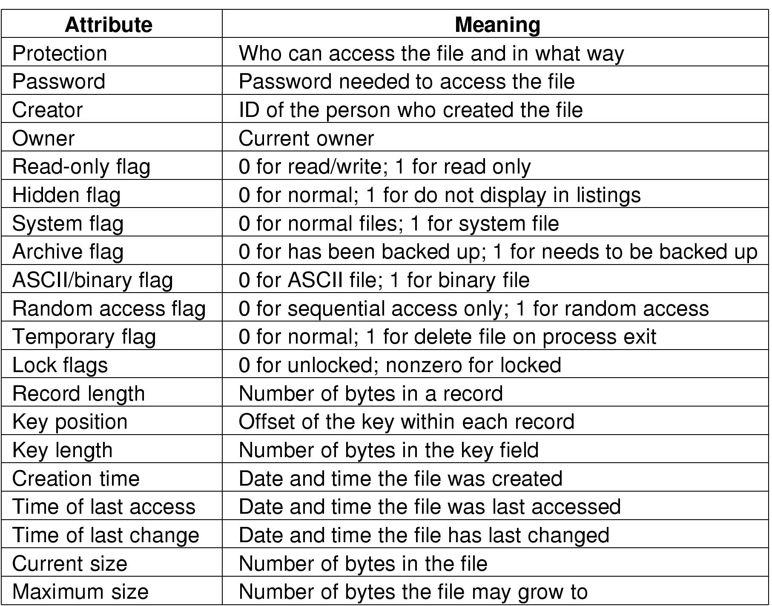
File Attributes
Possible file attributes

Slide 15
File Operations
  Create
  Delete
  Open
  Close
  Read
  Write
  Append
  Seek
  Get attributes
  Set Attributes
  Rename

Slide 16
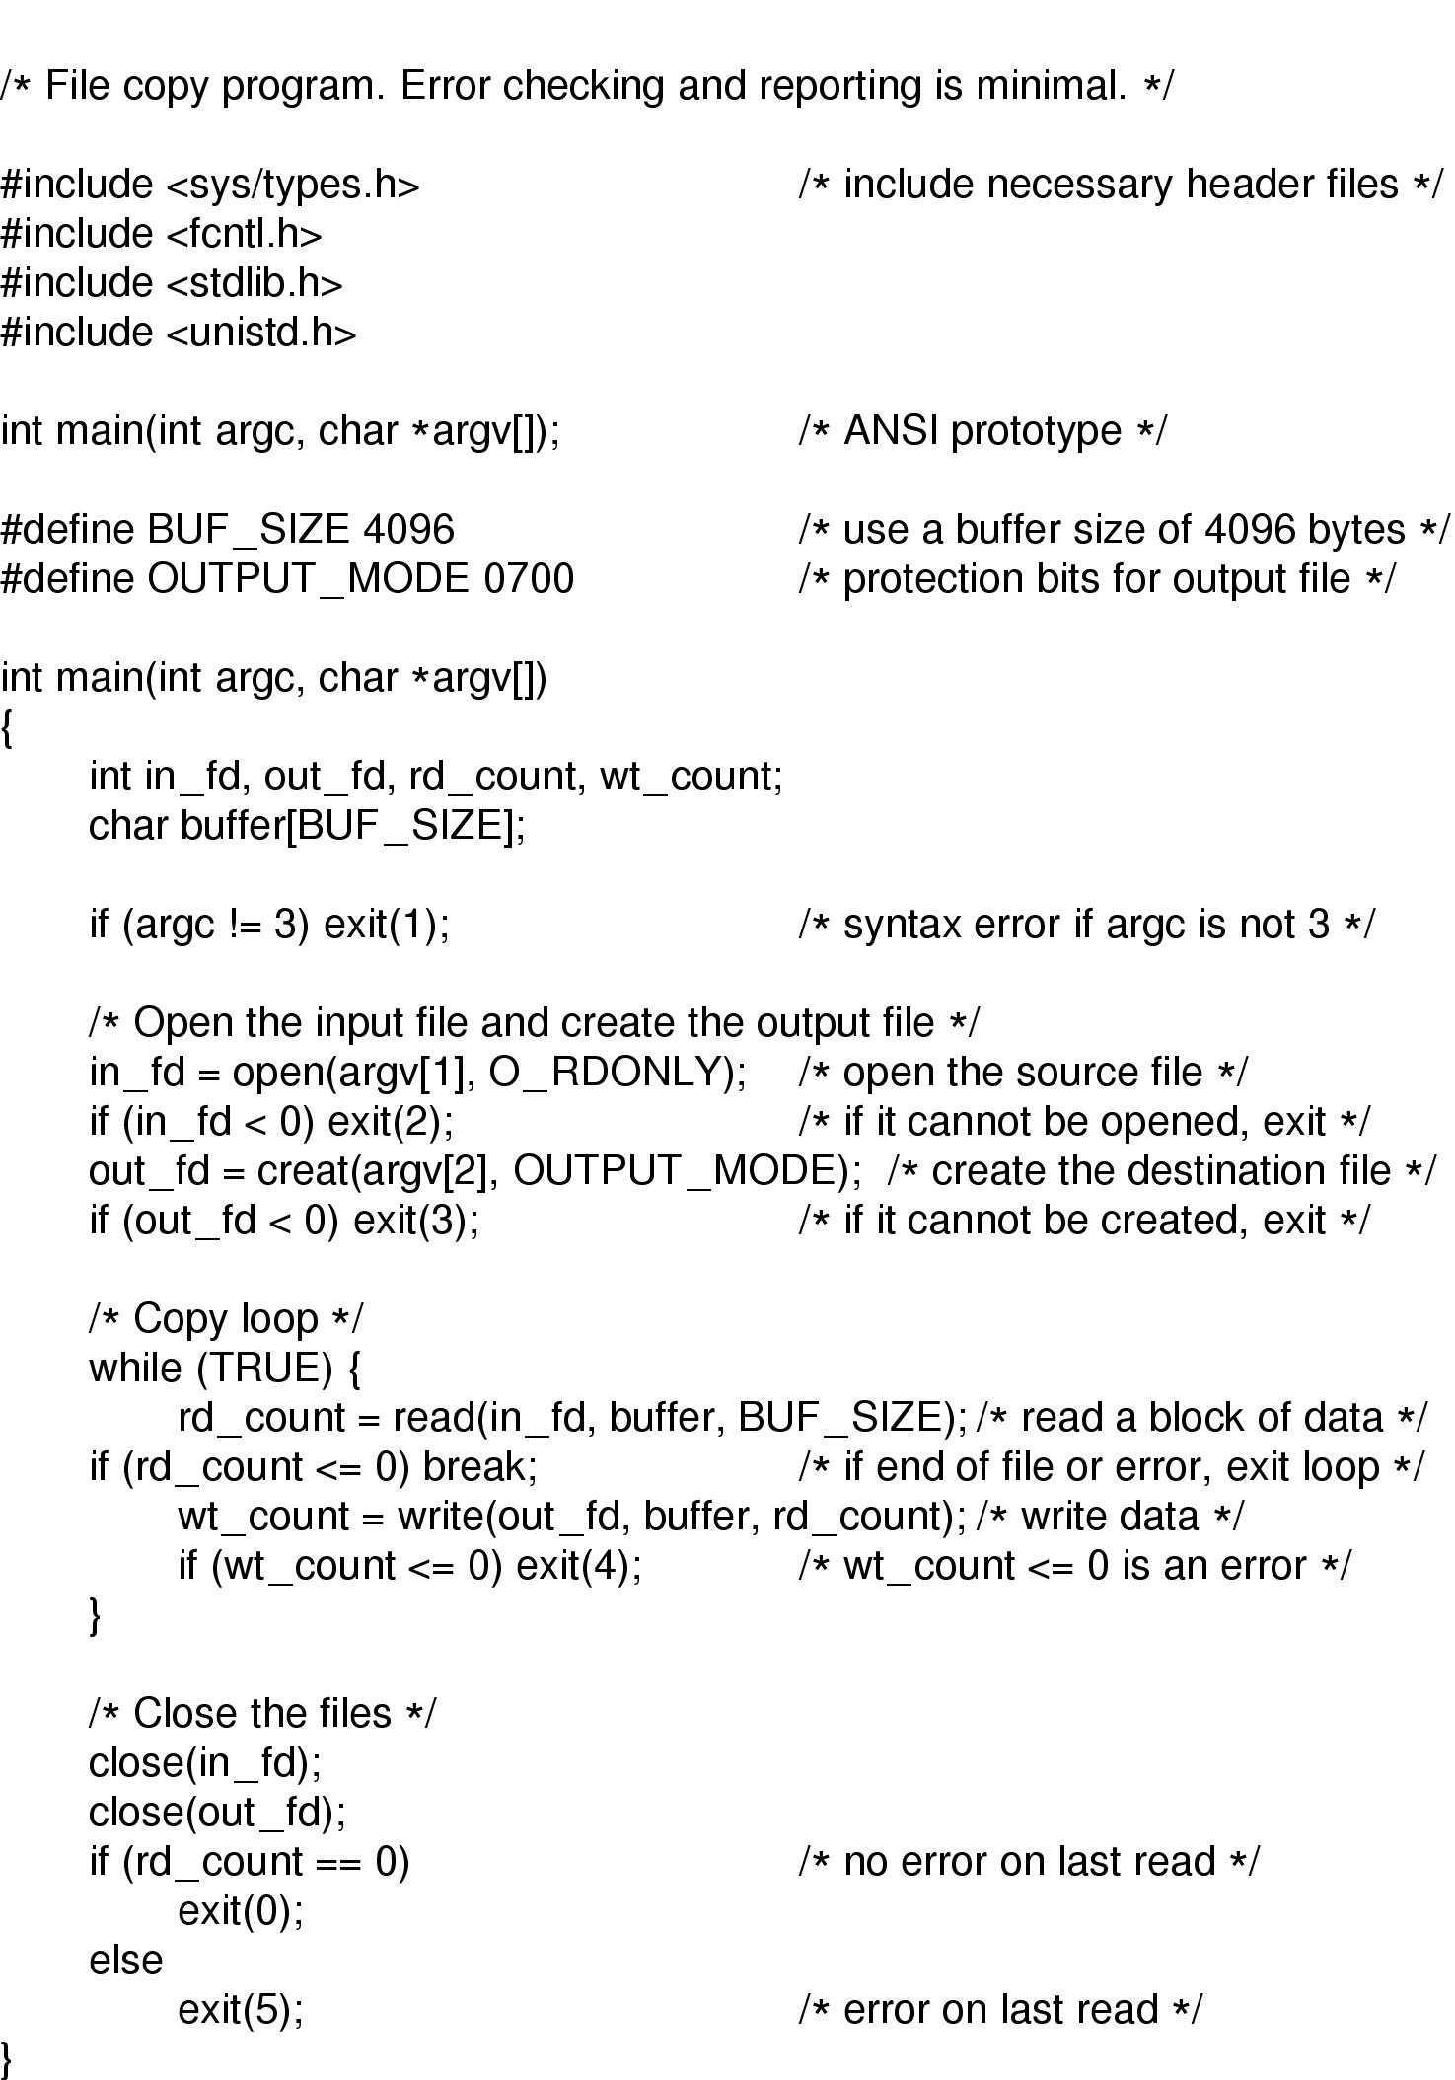
An Example Program Using File System Calls (1/2)

Slide 17
An Example Program Using File System Calls (2/2)

Slide 18
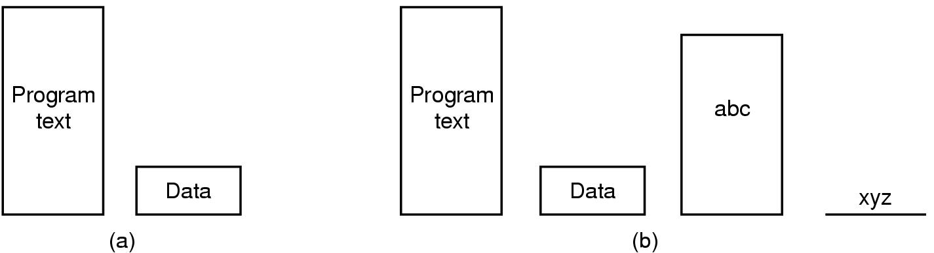
Memory-Mapped Files
(a) Segmented process before mapping files into its address space
(b) Process after mapping
  existing file abc into one segment
  creating new segment for xyz

Slide 19
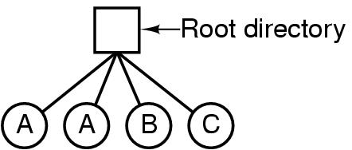
Directories
Single-Level Directory Systems
A single level directory system
  contains 4 files
  owned by 3 different people, A, B, and C

Slide 20
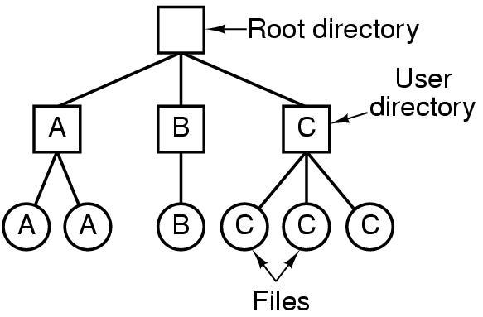
Two-level Directory Systems
Letters indicate owners of the directories and files

Slide 21
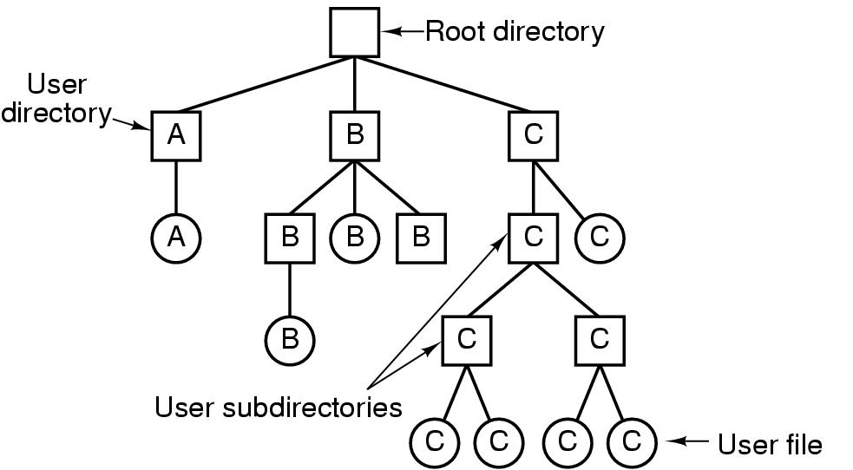
Hierarchical Directory Systems
A hierarchical directory system

Slide 22
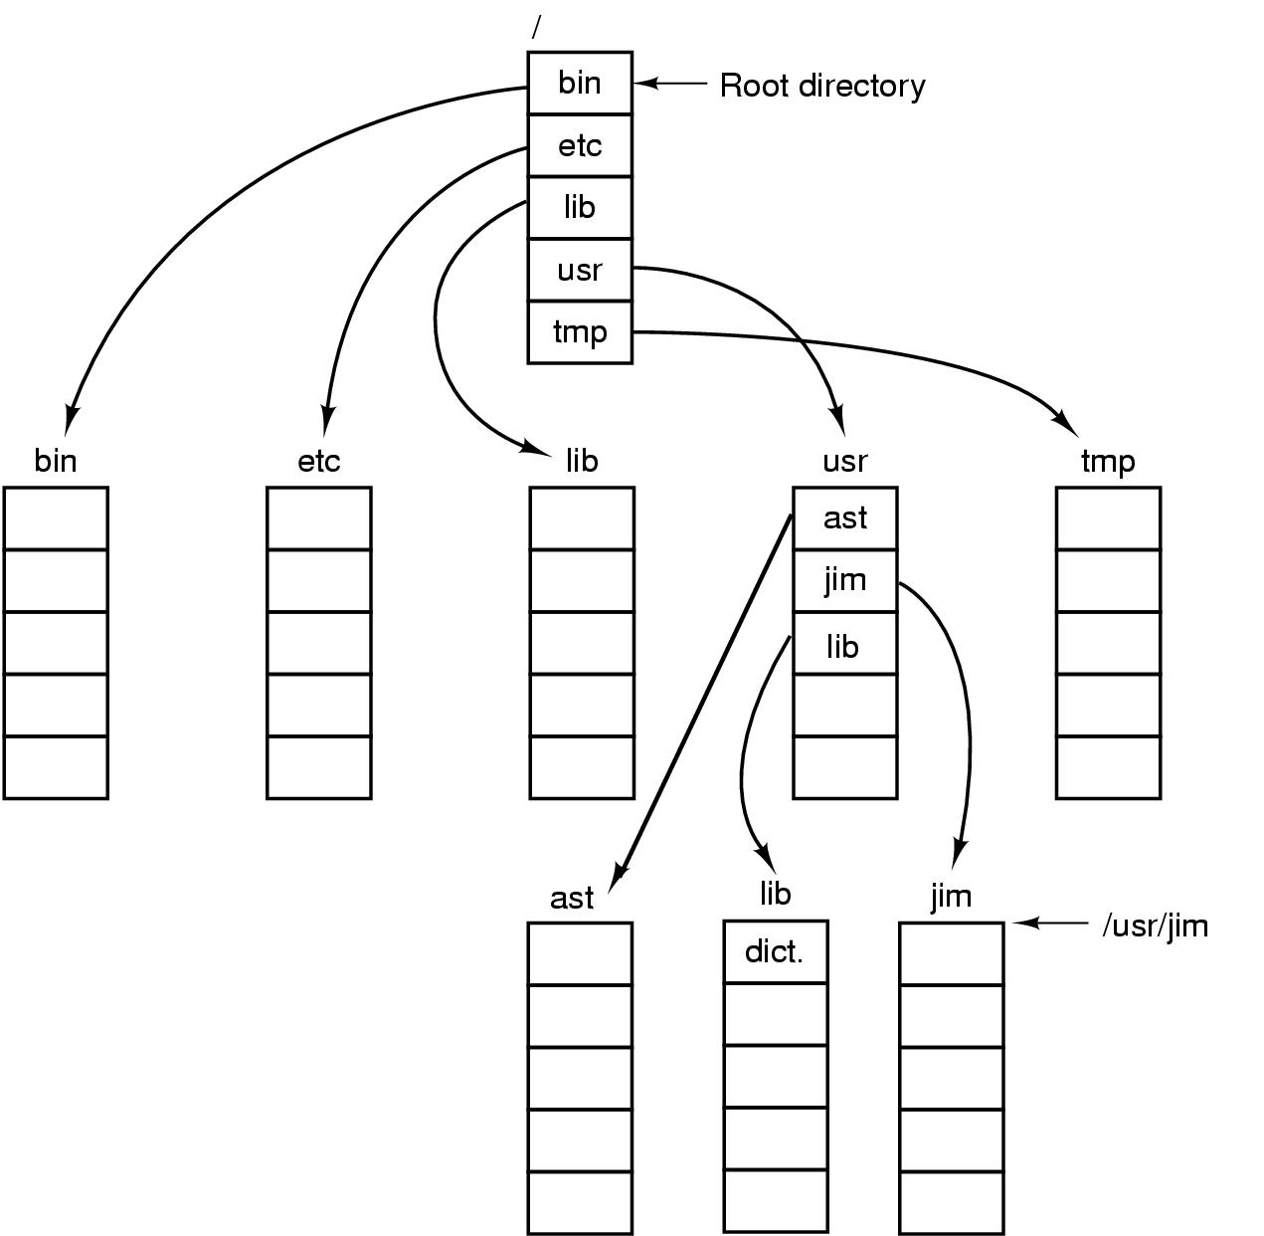
Path Names
A UNIX directory tree

Slide 23
Directory Operations
Create
Delete
Opendir
Closedir
Readdir
Rename
Link
Unlink

Slide 24
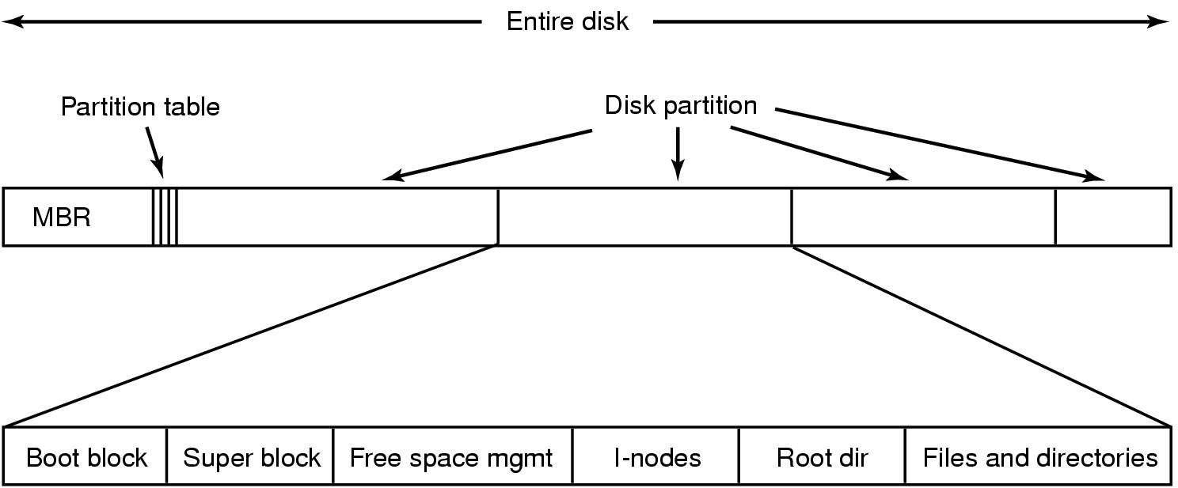
File System Implementation
A possible file system layout

Slide 25
File System Implementation
File systems are stored on disks.
Most disks can be divided up into one or more partitions with independent file systems on each partition.
Sector 0 of the disk is called the MBR (Master Boot Record)
  Is used to boot the computer.
The end of the MBR contains the partition table.
  This table gives the starting and ending addresses of each partition.
  One of the partitions in the table is marked as active.
When computer is booted, the BIOS reads in and executes the MBR.
The first thing the MBR program does is locate the active partition, read in its first block,called boot block and execute it.
The program in the boot block loads the OS contained in that partition.

Slide 26
File System Implementation
Other than starting with a boot block, layout of disk partition varies strongly from file system to file system.
Often the file system will contain some of the items.
The first one is the superblock.
It contains all the key parameters about the file system and is read into memory when the computer is booted or the file system is first touched.
Typical information in the superblock includes
  A magic number to identify the file system type.
  The number of blocks in the file system.
  Other key administrative information.
Next might come information about free blocks in the file system (for example in the form of a bitmap or list of pointers).
This might be followed by the i-node, an array of data structures, one per file, telling all about the file.
After that might come the root directory, which contains the top of the file system tree.
Finally, the remainder of the disk contains all other directories and files.

Slide 27

Implementing Files (1)
(a) Contiguous allocation of disk space for 7 files
(b) State of the disk after files D and E have been removed

Slide 28
Implementing Files
Simplest allocation scheme is to store each file as a contiguous run of disk blocks.
Thus on a disk with 1-KB blocks, a 50-KB file would be allocated 50 consecutive blocks.
With 2-KB blocks, it would be allocated 25 consecutive blocks.
Contiguous disk space allocation has two significant advantages.
First, it is simple to implement because keeping track of where a file’s blocks are reduced to remembering two numbers: the disk address of the first block and the number of blocks in the file.
Second, the read performance is excellent because the entire file can be read from the disk in a single operation.
  Only one seek is needed to the first block

Slide 29
Implementing Files
Contiguous allocation has a significant drawback: in time, the disk becomes fragmented.
To see how this comes about, suppose two files D and F have been removed.
When a file is removed, its blocks are freed, leaving a run of free blocks following the hole.
As a result the disk ultimately consists of files and holes.
Contiguous allocation is feasible and widely used on CD-ROMS.
  Here all file sizes are known in advance and will never change during subsequent use of CD-ROM file system.

Slide 30

Implementing Files (2)
Storing a file as a linked list of disk blocks

Slide 31
Implementing Files
The second method for storing files is to keep each one as a linked list of disk blocks.
The first word of each block is used as a pointer to the next one. The rest of the block is for data.
Here every data block can be used.
No space is lost to disk fragmentation.
Also it is sufficient for the directory entry to merely store the disk address of the first block. The rest can be found starting there.
However, although reading a file sequentially is straightforward, random access is extremely slow.
Also amount of data storage in a block is no longer a power of two because the pointer takes up a few bytes.
With the first few bytes of each block occupied to a pointer to the next block, reads of the full block size require acquiring and concatenating information from two disk blocks, which generates extra overhead due to the copying.

Slide 32
Linked List Allocation Using a Table in Memory
Both disadvantages of the linked list allocation can be eliminated by taking the pointer word from each disk block and putting it in a table in memory.
Such a table in main memory is called a FAT (File Allocation Table).
Using this organization, the entire block is available for data.
Also random access is much easier.
  Although, the chain must still be followed to find a given offset within the file, the chain is entirely in memory, so it can be followed without making any disk references.
The primary disadvantage is that the entire table must be in memory all the time to make it work.

Slide 33
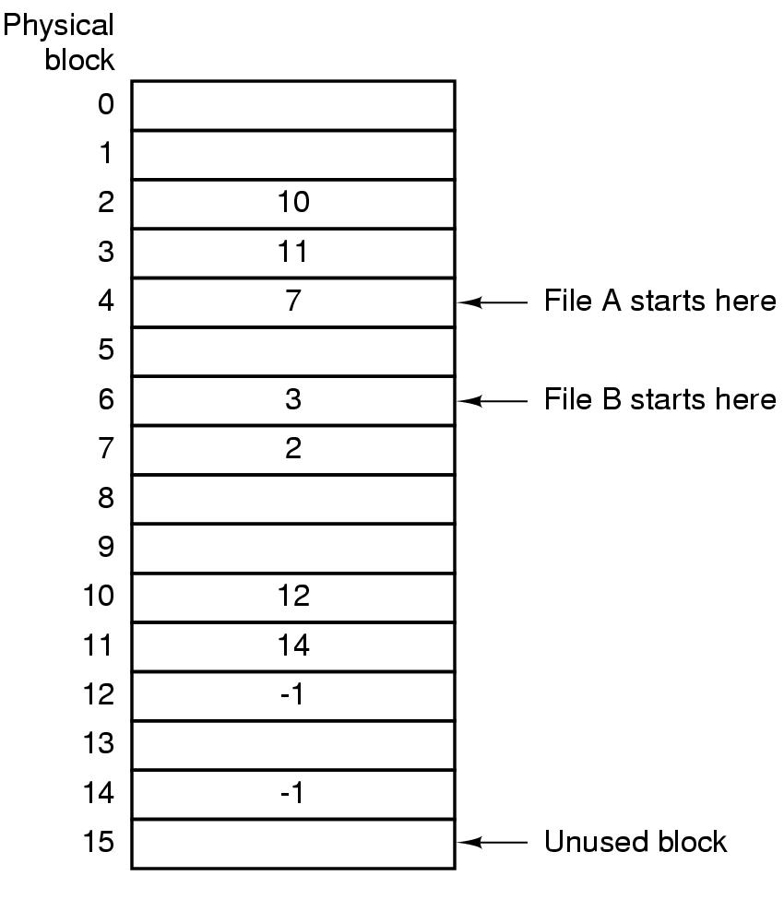
Implementing Files (3)
Linked list allocation using a file allocation table in RAM

Slide 34
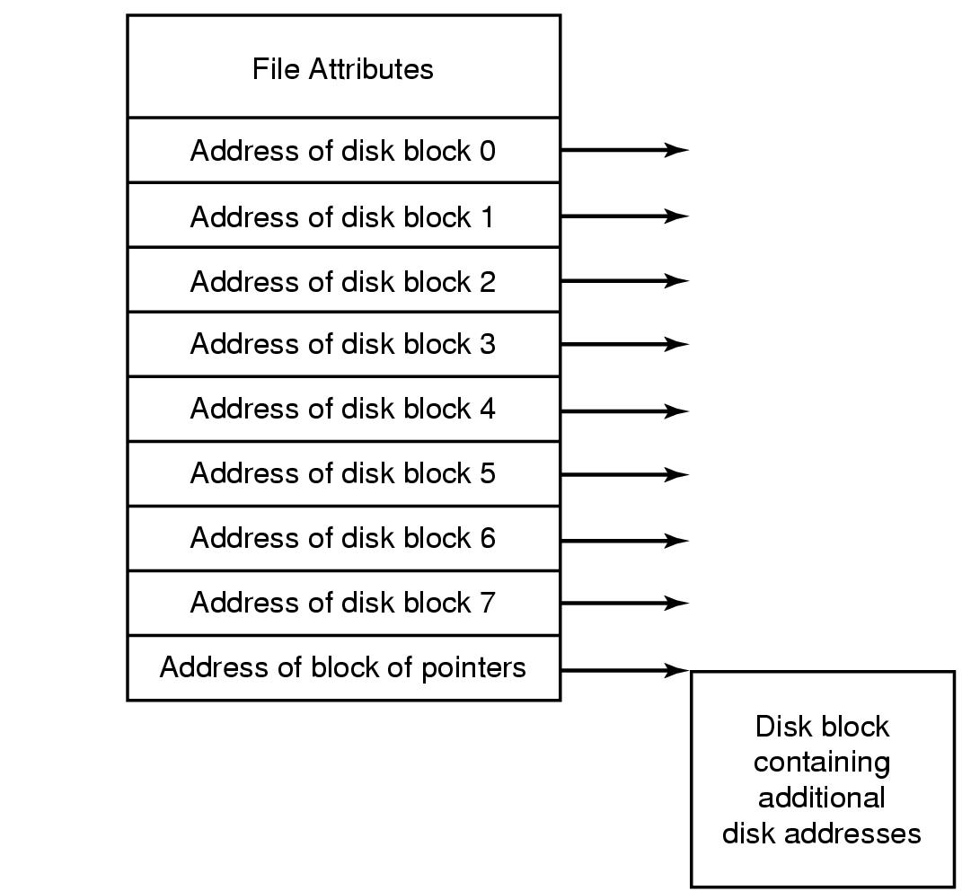
Implementing Files (4)
An example i-node

Slide 35
I-nodes
This method is keeping track of which blocks belong to which file is to associate with each file a data called an i-node (index-node) which lists the attributes and disk addresses of the file’s blocks.
Given the i-node, it is then possible to find all the blocks of the file.
This scheme needs the i-node only to be in memory when the corresponding file is open.
If each i-node occupies n bytes and a maximum of k files may be open at once, the total memory occupied by the array holding the i-nodes for the open files is only kn bytes.

Slide 36
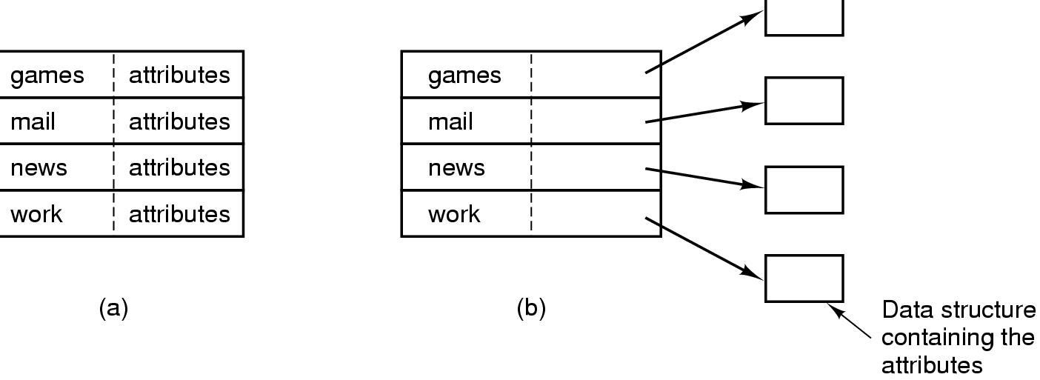
Implementing Directories (1)
(a) A simple directory
  fixed size entries
  disk addresses and attributes in directory entry
(b) Directory in which each entry just refers to an i-node

Slide 37
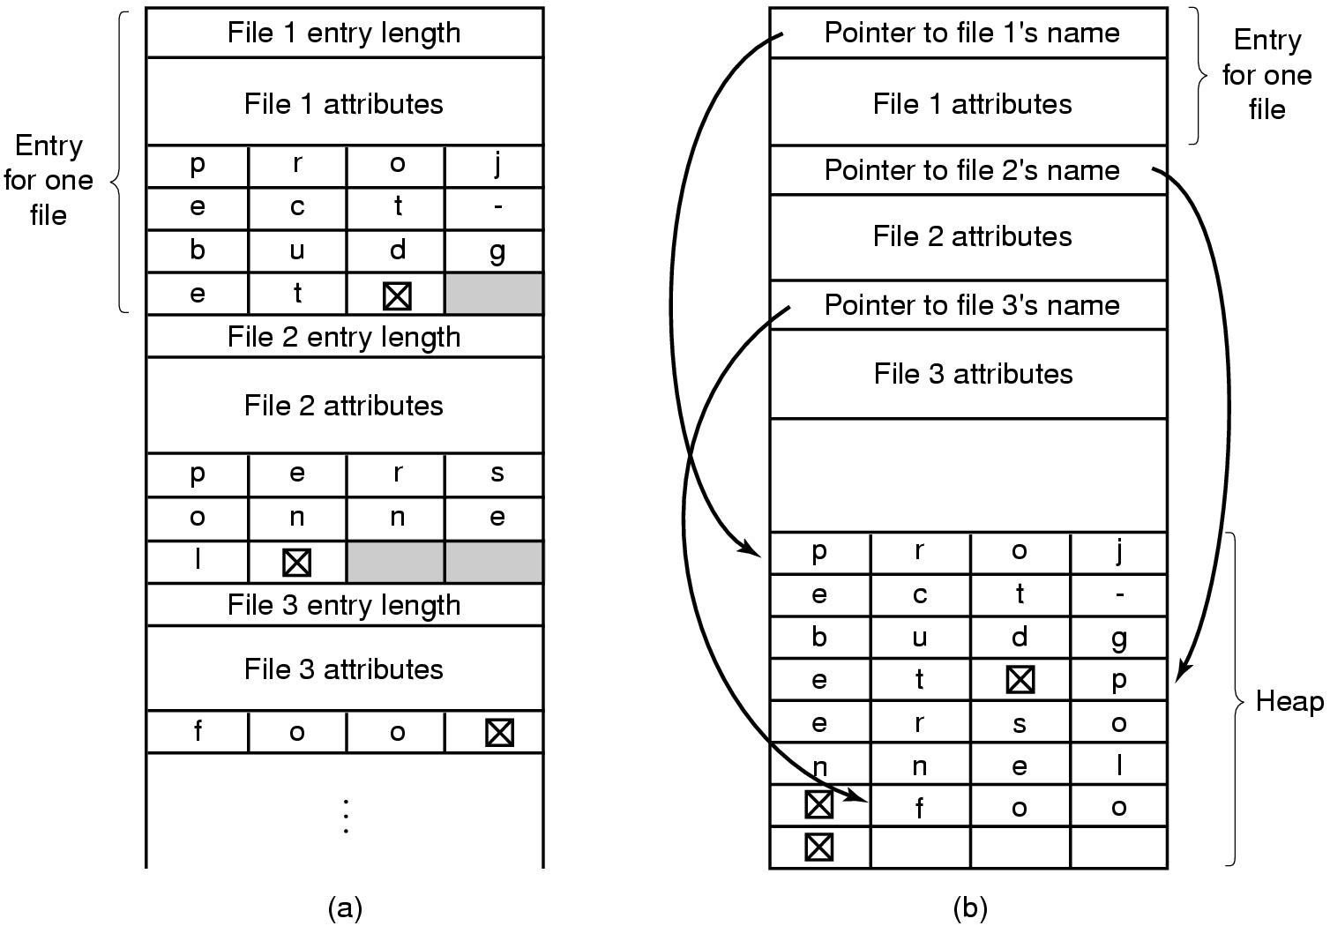
Implementing Directories (2)
Two ways of handling long file names in directory
  (a) In-line
  (b) In a heap

Slide 38
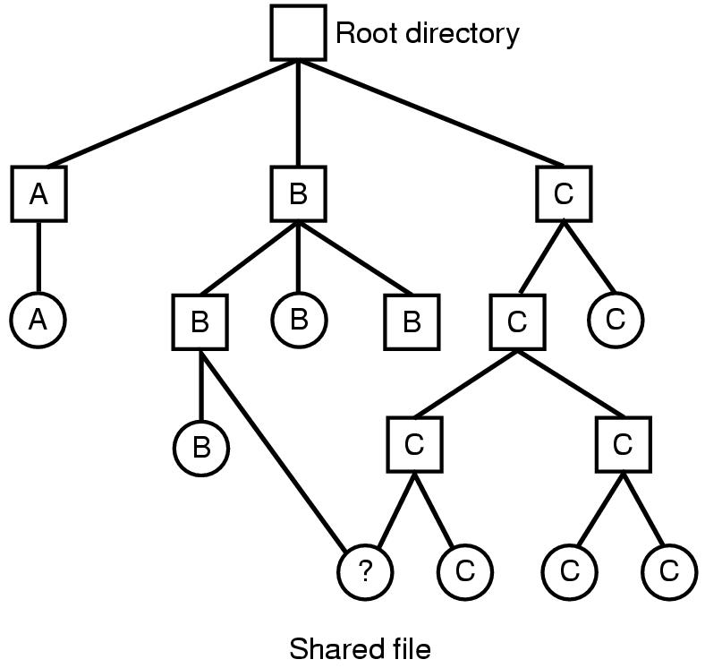
Shared Files (1)
File system containing a shared file

Slide 39
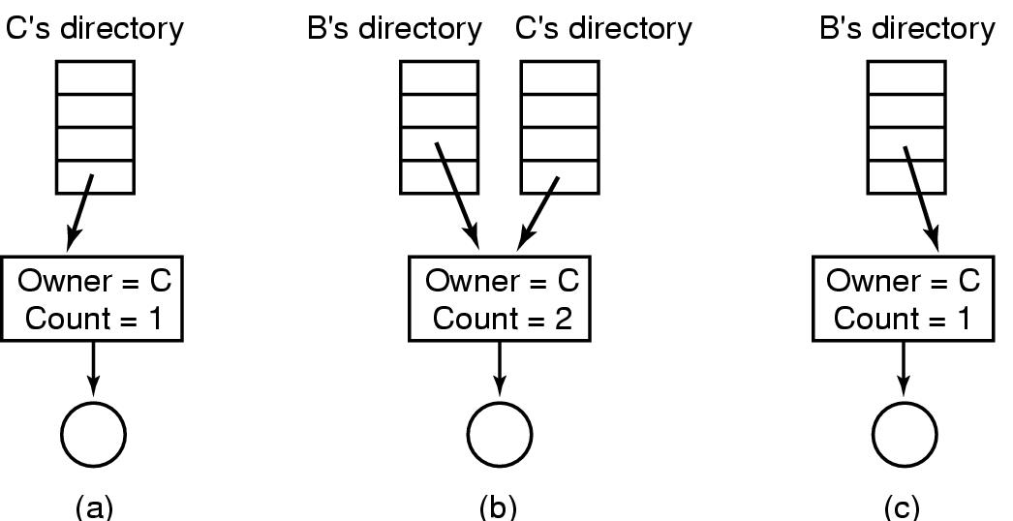
Shared Files (2)
(a) Situation prior to linking
(b) After the link is created
(c)After the original owner removes the file

Slide 40
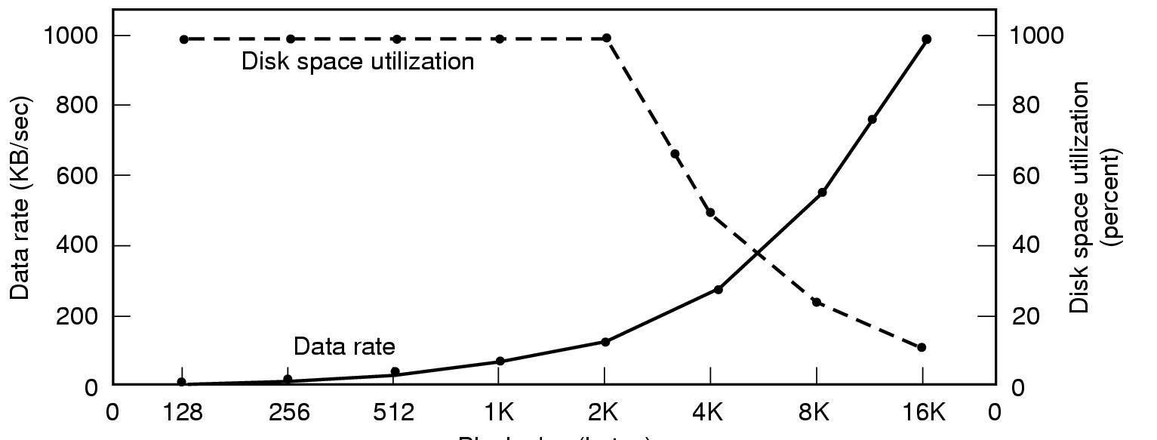
Disk Space Management (1)
Block size
Dark line (left hand scale) gives data rate of a disk
Dotted line (right hand scale) gives disk space efficiency
All files 2KB

Slide 41
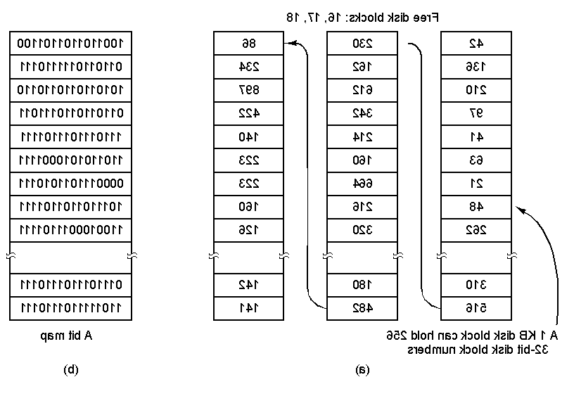
Disk Space Management (2)
(a) Storing the free list on a linked list
(b) A bit map

Slide 42
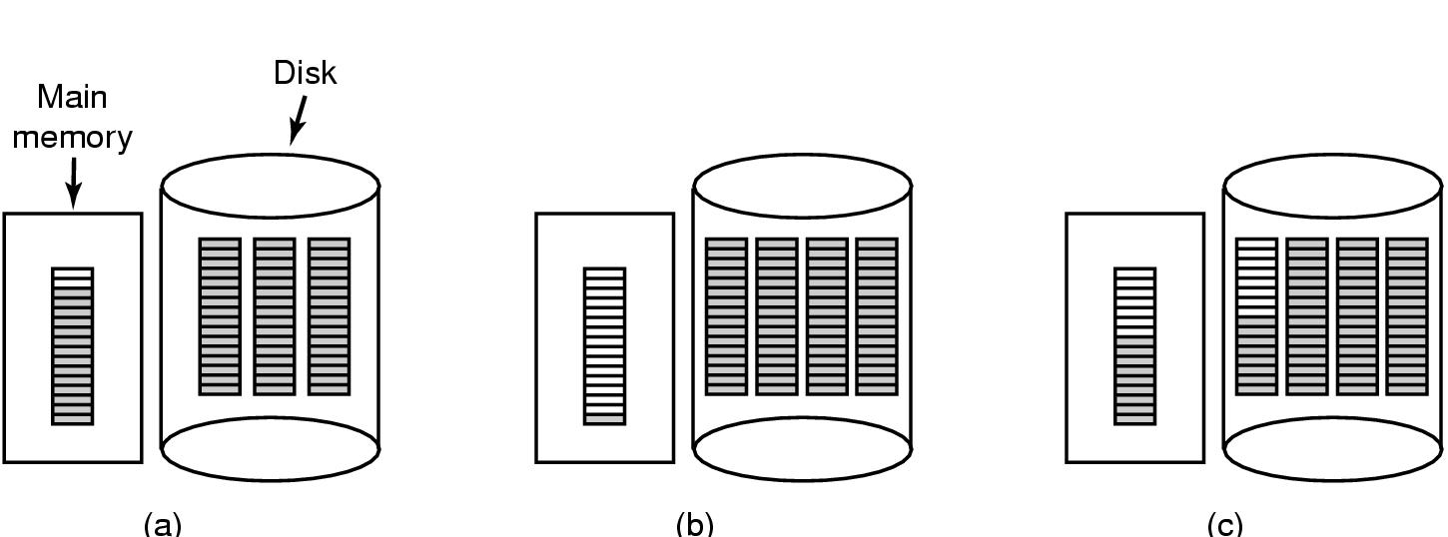
Disk Space Management (3)
(a) Almost-full block of pointers to free disk blocks in RAM
  - three blocks of pointers on disk
(b) Result of freeing a 3-block file
(c) Alternative strategy for handling 3 free blocks
  - shaded entries are pointers to free disk blocks

Slide 43
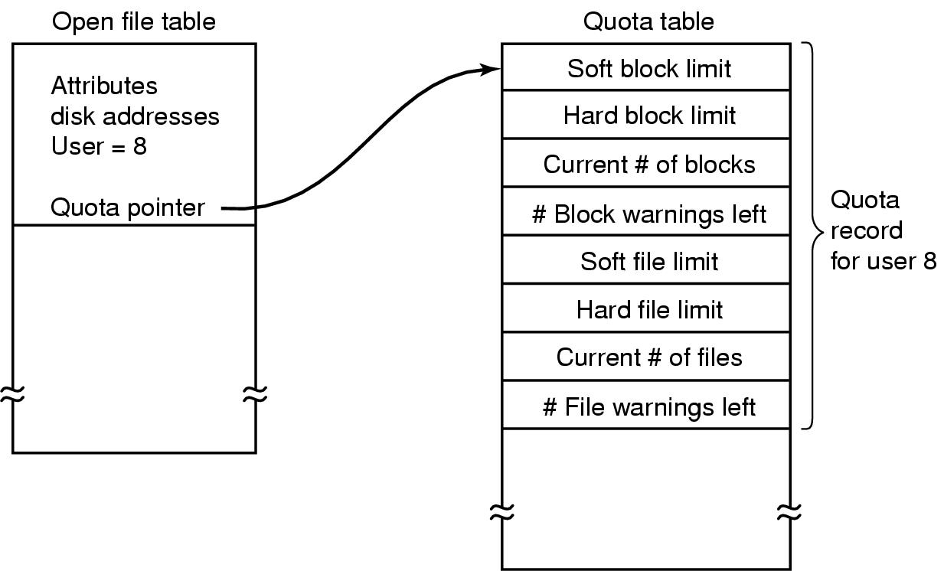
Disk Space Management (4)
Quotas for keeping track of each user’s disk use

Slide 44
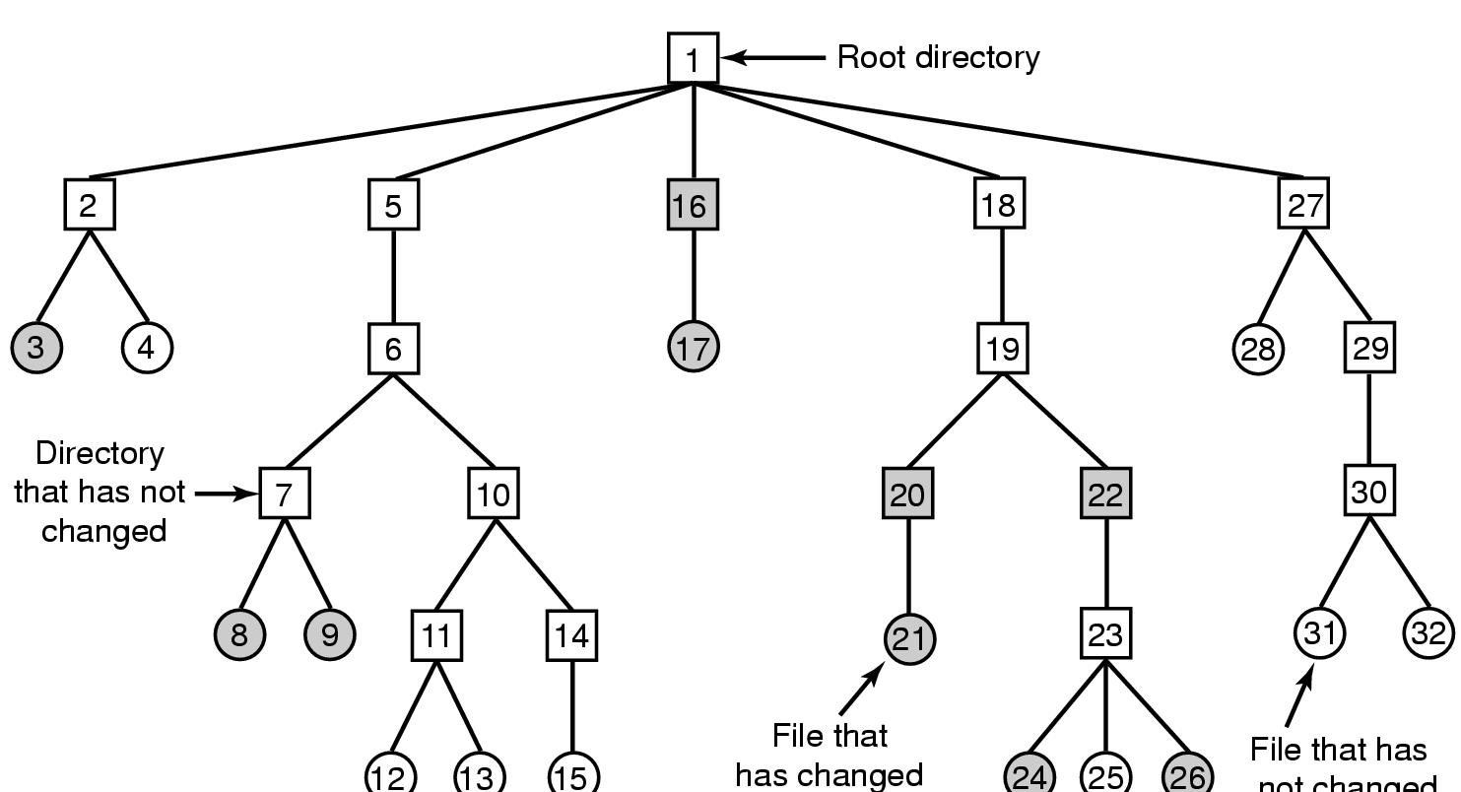
File System Reliability (1)
File that has
not changed
A file system to be dumped
  squares are directories, circles are files
  shaded items, modified since last dump
  each directory & file labeled by i-node number

Slide 45
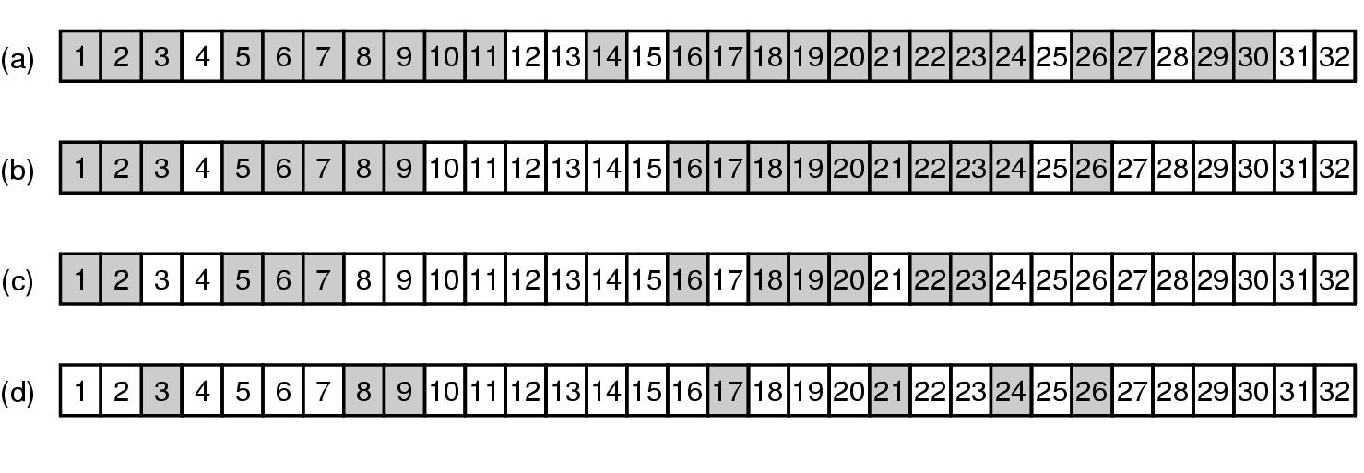
File System Reliability (2)
Bit maps used by the logical dumping algorithm

Slide 46
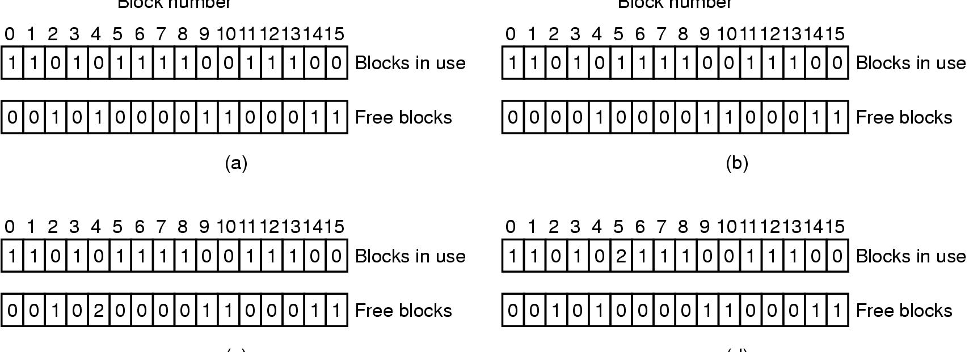
File System Reliability (3)
File system states
  (a) consistent
  (b) missing block
  (c) duplicate block in free list
  (d) duplicate data block

Slide 47
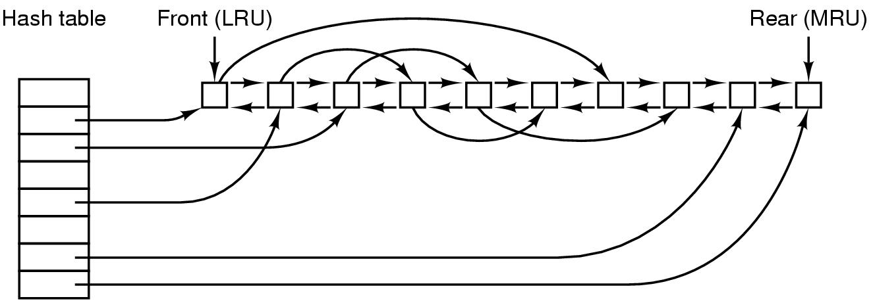
File System Performance (1)
The block cache data structures

Slide 48

File System Performance (2)
I-nodes placed at the start of the disk
Disk divided into cylinder groups
  each with its own blocks and i-nodes

Slide 49
Log-Structured File Systems
With CPUs faster, memory larger
  disk caches can also be larger
  increasing number of read requests can come from cache
  thus, most disk accesses will be writes
LFS Strategy structures entire disk as a log
  have all writes initially buffered in memory
  periodically write these to the end of the disk log
  when file opened, locate i-node, then find blocks

Slide 50
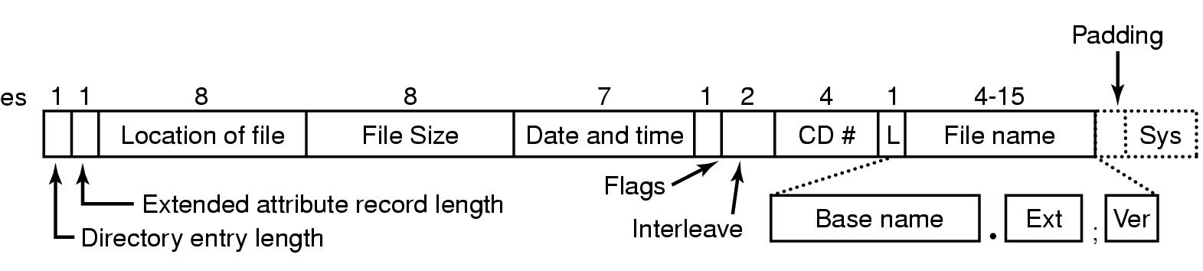
Example File Systems
CD-ROM File Systems
The ISO 9660 directory entry

Slide 51
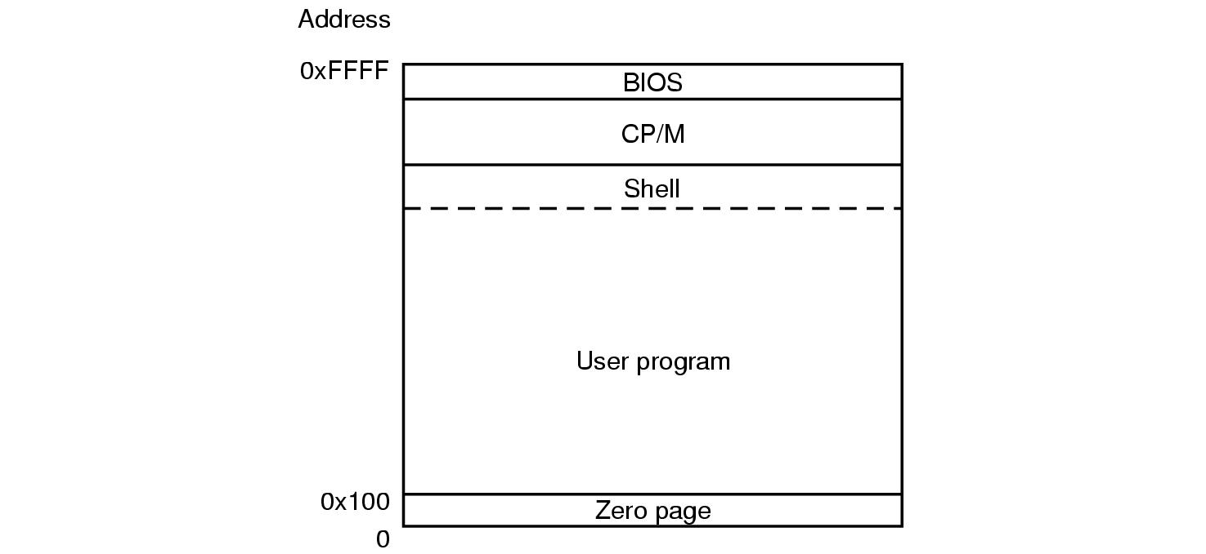
The CP/M File System (1)
Memory layout of CP/M

Slide 52
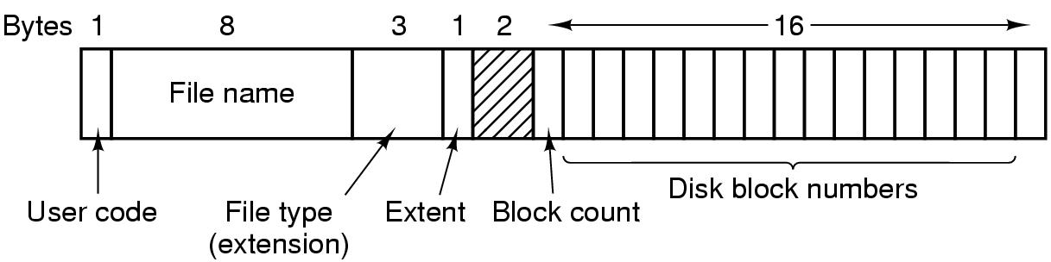
The CP/M File System (2)
The CP/M directory entry format

Slide 53
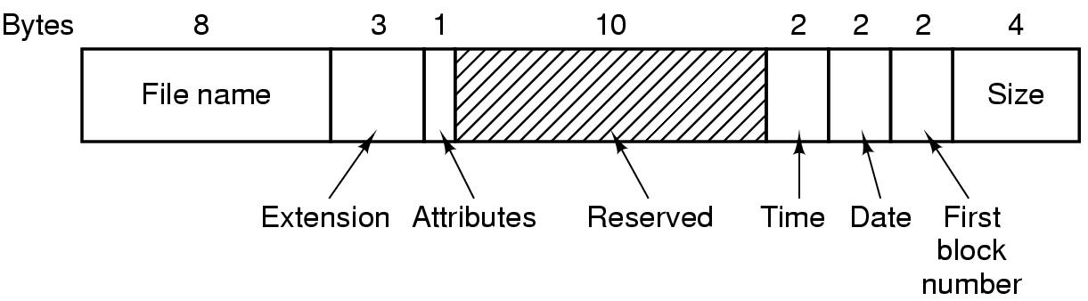
The MS-DOS File System (1)
The MS-DOS directory entry

Slide 54
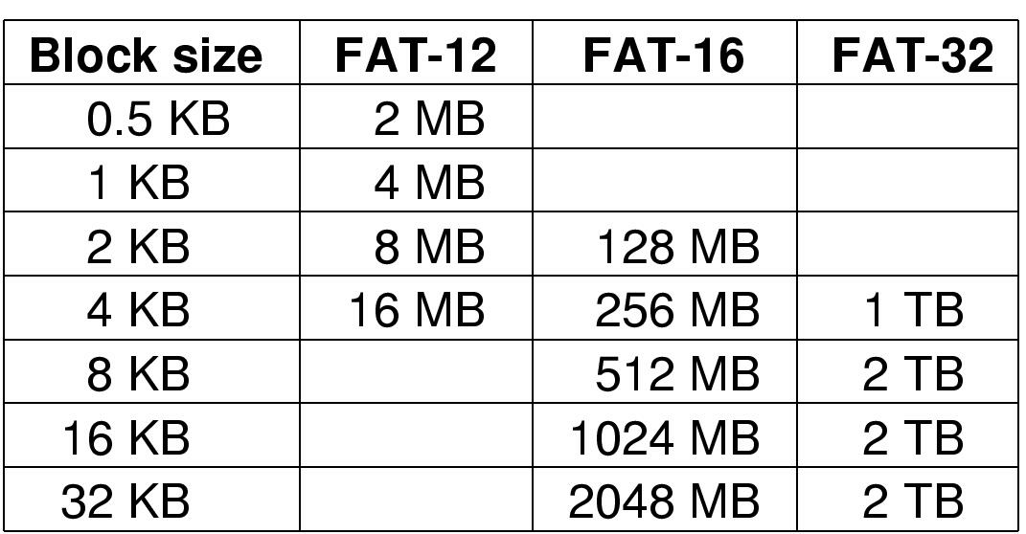
The MS-DOS File System (2)
Maximum partition for different block sizes
The empty boxes represent forbidden combinations

Slide 55
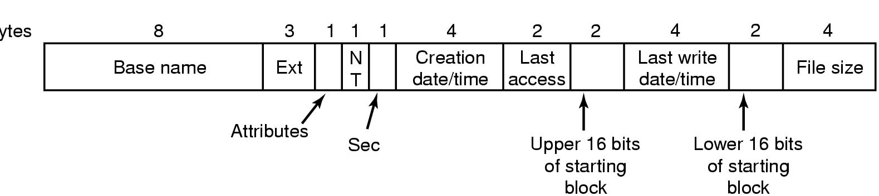
The Windows 98 File System (1)
Bytes
The extended MOS-DOS directory entry used in Windows 98

Slide 56
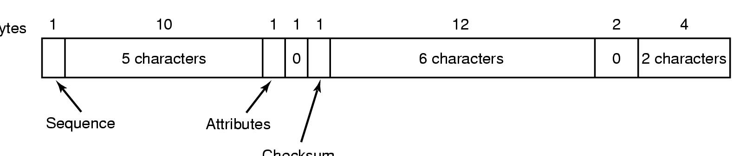
The Windows 98 File System (2)
Bytes
Checksum
An entry for (part of) a long file name in Windows 98

Slide 57
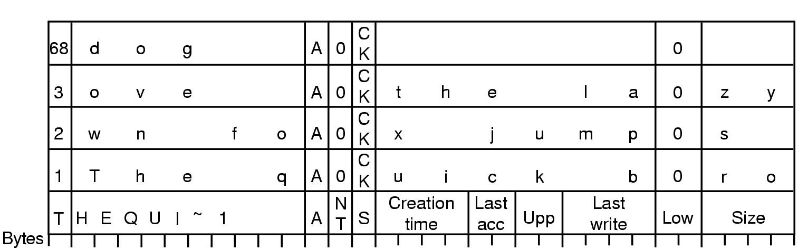
The Windows 98 File System (3)
An example of how a long name is stored in Windows 98

Slide 58
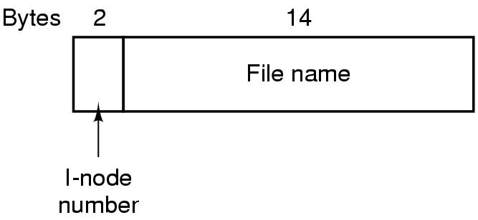
The UNIX V7 File System (1)
A UNIX V7 directory entry

Slide 59
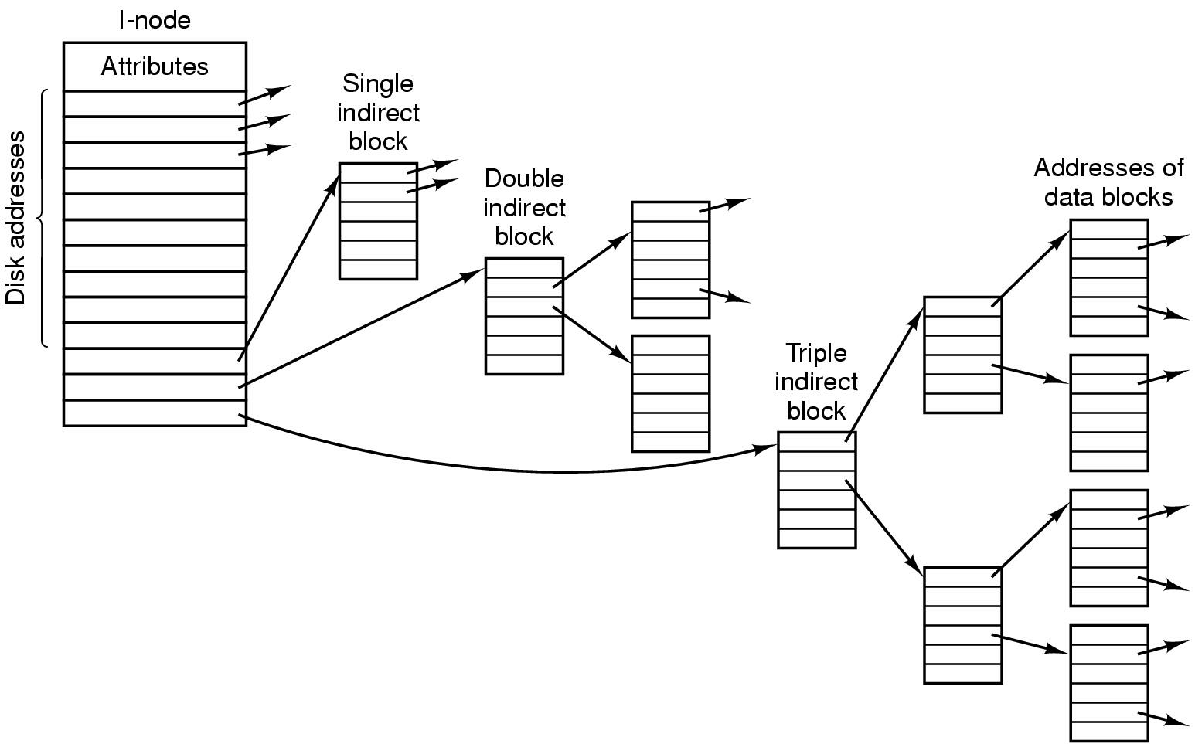
The UNIX V7 File System (2)
A UNIX i-node

Slide 60
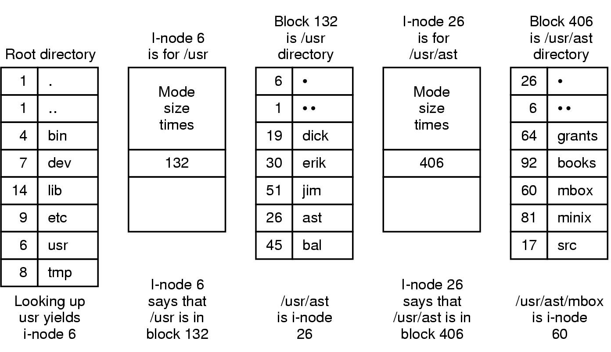
The UNIX V7 File System (3)
The steps in looking up /usr/ast/mbox

